Slide 1
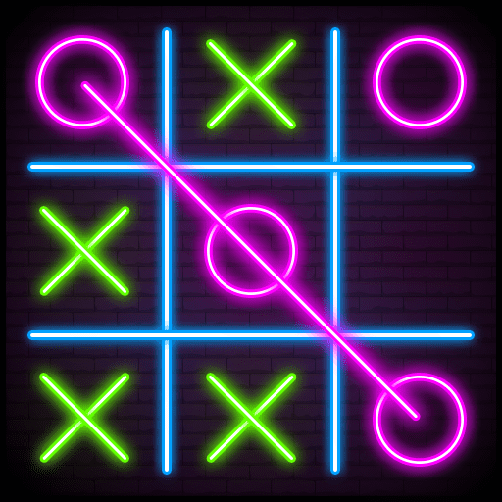
University OF NEW HAVEN "Advanced Tic-Tac-Toe AI: Exploring Q-Learning, Minimax, Alpha-Beta Pruning Techniques & BFS"
Bhargav
Sumanth

Slide 2
OBJECTIVE
This research focuses on comparing the
performance of search-based algorithms
and multi agents in the Tic Tac Toe
Game.
The goals include:
Develop AI agents using Q-learning, Herustic approach (BFS), Min-Max, and herustic Alpha-Beta Pruning for Tic Tac Toe.
Compare their performance based on accuracy, efficiency, and complexity.
Identify the most effective approach for solving the game.

Slide 3
APPROACH
To achieve the project objectives, the following methodologies and tools will be employed:
Reinforcement Learning:
Implementation of the Q-learning technique using the Epsilon-greedy strategy, State and action spaces are in Tabular form, and reward functions are +1(winning),0(Draw),-1(Implicit).
Adversarial Search:
Min-Max Algorithm: Design an agent that evaluates all possible moves and counter-moves to determine the optimal strategy.
Herustic Alpha-Beta Pruning: search efficiently finds the best ai move buy pruning suboptimal branches and using a Herustic to evaluate the game states.
BFS:
Explore a graph level by level ensuring the shortest path in an unweighted graph.

Slide 4
DELIVERABLES
1. Project Report
2. AI Algorithm Implementations
4. Comparison Metrics
5. Experimental Data Visualizations
6. Conclusion
7. Code
8.Documentation

Slide 5
Evaluation
The evaluation of the AI agents developed for solving the Tic Tac Toe game will be conducted based on the following criteria:
Win Rate: Count the number of games each agent wins in repeated one-on-one Tic Tac Toe matches.
Algorithm Verification: Ensure that the BFS, Q-learning using epsilon –greedy search approach vs human agent & heuristic alpha beta search , Min-Max vs heuristic Alpha-Beta Pruning agents are implemented correctly and function as intended in the Tic Tac Toe environment.
Playing multiple times of Tic Tac toe games and checks the winning case percentage of the algorithms. Between the AI agents.
This approach ensures a detailed and reliable evaluation of the agents' effectiveness in mastering the game.

Slide 6
COMPARISION TABLE
HUMAN VS AI AGENTS
 | WINS PERCENTAGE | LOSE PERCENTAGE
Q-LEARNING WITH EPSILON GREEDY STATERGY | 90.3 | 9.7
HERUSTIC ALPHA BETA PRUNING | 94.7 | 5.3
BFS | 92 | 8
AI AGENTS VS AI AGENTS
 | WINS PERCENTAGE
 | AI-1 | AI-2
Q-LEARNING WITH EPSILON GREEDY STATERGY (AI-1) VS HERUSTIC ALPHA BETA PRUNING (AI-2) | 5.2 | 94.8
HERUSTIC ALPHA BETA PRUNING (AI-1) VS MINIMAX (AI-2) | 96.7 | 3.2

Slide 7
Comparison graphs over game plays

Slide 8
CONCLUSION
This project explores AI approaches to solving Tic Tac Toe between the AI agents and human
Tic tac toe is implemented using the heuristic search approach i.e; Bfs
By evaluating win rates, computational efficiency, and accuracy, the most effective strategy is identified, Alpha-Beta pruning mini-max with a heuristic approach offering insights into the strengths of reinforcement learning.
The findings provide a foundation for applying these techniques to more complex problems while enhancing understanding of AI-driven decision-making in games.

